Slide 1
Multivariate deep sequences
Additional Noise and Impulse Functions
Gene Olafsen

Slide 2
Additional noise channel
data = pd.read_csv('https://raw.githubusercontent.com/jaungiers/MvTAe-Multivariate-Temporal-Autoencoder/master/data.csv', header=0)
data.loc[:,'noise2'] = 6.0 * data['noise']
data.loc[data.index[[0, -1]], 'noise2'] = data.loc[data.index[[-1, 0]], 'noise2'].to_numpy()
data = data[['noise', 'noise2', 'sine_1', 'sine_2', 'combined']]

Slide 3
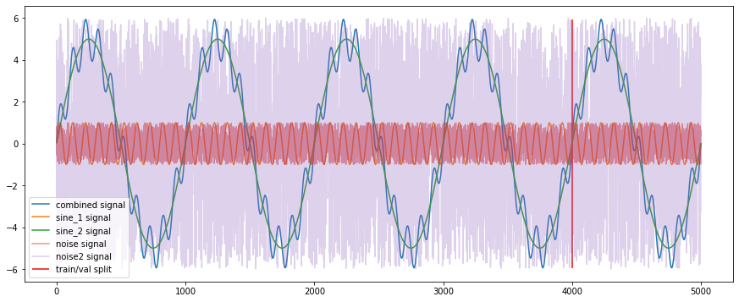
Adding Noise
A second noise signal is introduced, whose amplitude matches the sine_2 signal.

Slide 4
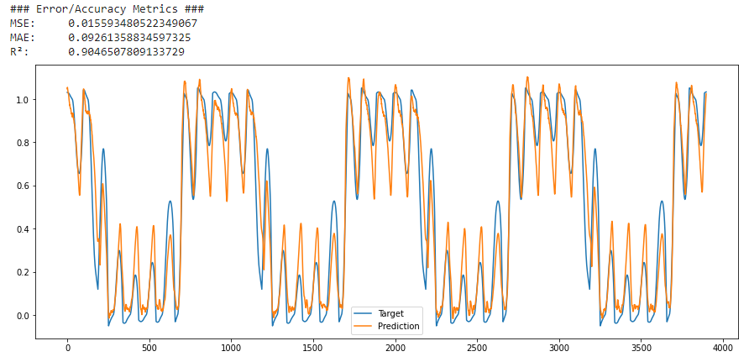
Alpha target branch prediction (+noise_2)

Slide 5
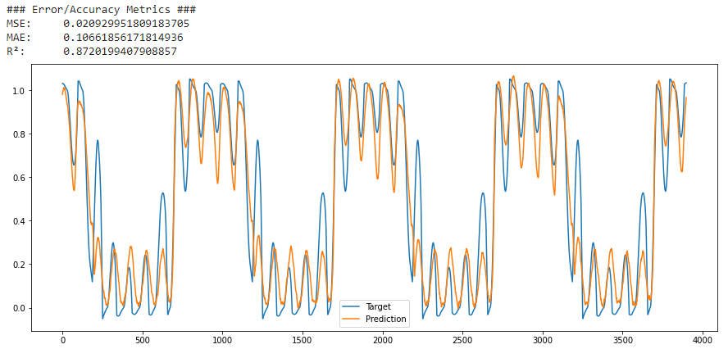
Alpha target branch prediction (Original)

Slide 6
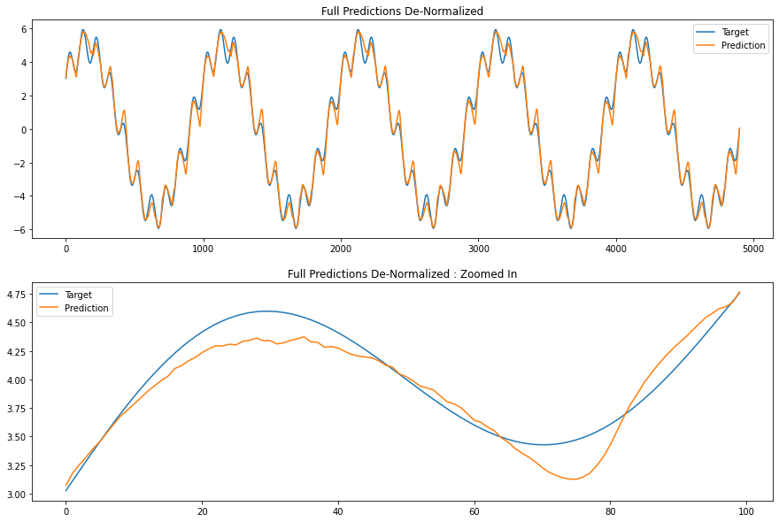
Full prediction denormalized (+noise_2)

Slide 7
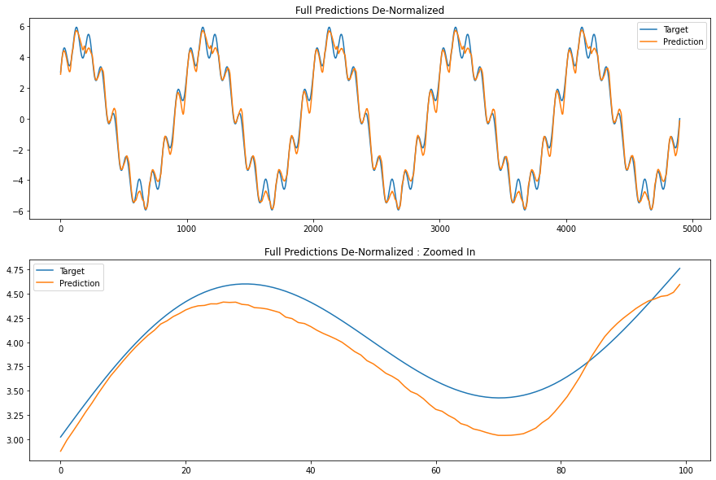
Full prediction denormalized (original)

Slide 8
overlay impulse to sine_1
data = data[['noise', 'noise2', 'sine_1', 'sine_2', 'combined']]
seed(1)
for i in range(10):
r = randint(0,4999)
data.loc[r,'sine_1'] = 10

Slide 9
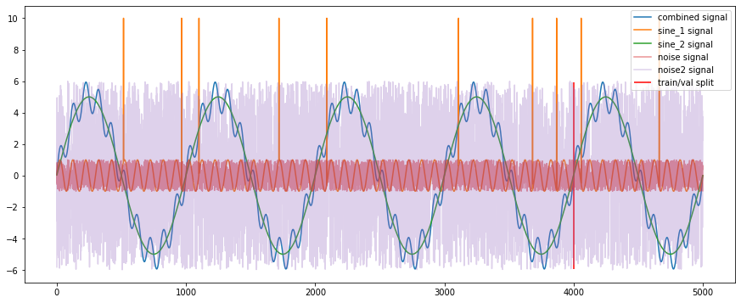
Alpha target branch prediction (+noise_2 and impulse)

Slide 10
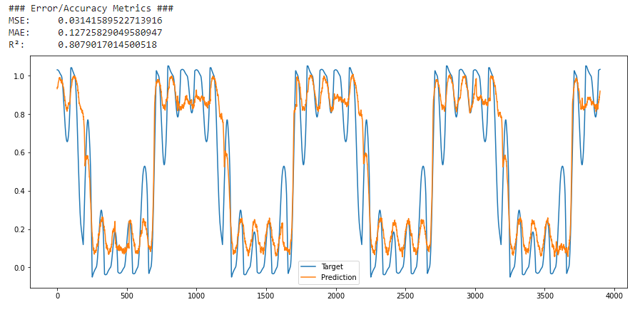
Alpha target branch prediction (+noise_2 and impulse)

Slide 11
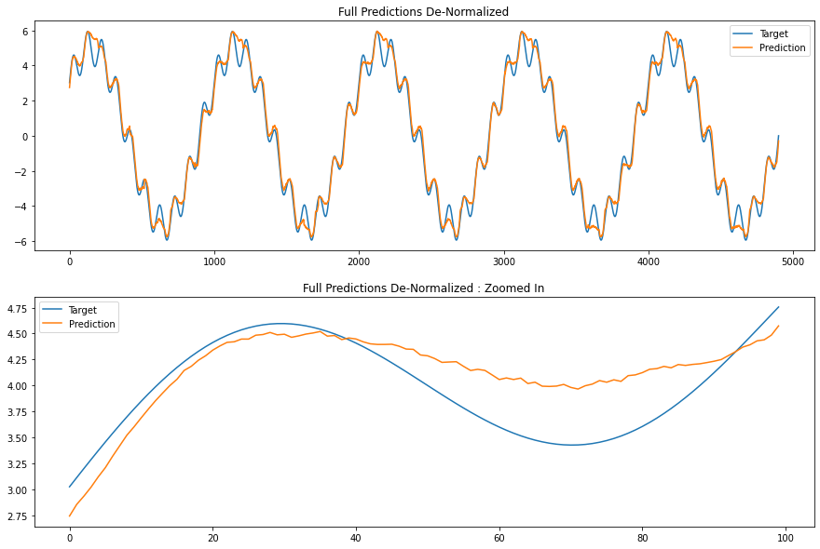
Full prediction denormalized (+noise_2 and impulse)

Slide 12
overlay impulse of Combined
data = data[['noise', 'noise2', 'sine_1', 'sine_2', 'combined']]
seed(1)
for i in range(10):
r = randint(0,4999)
print(data.loc[r,'combined'])
data.loc[r,'combined'] = 10

Slide 13
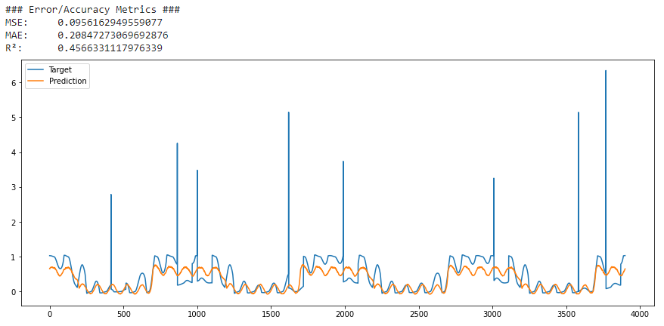
Alpha target branch prediction (+noise_2 and impulse)

Slide 14
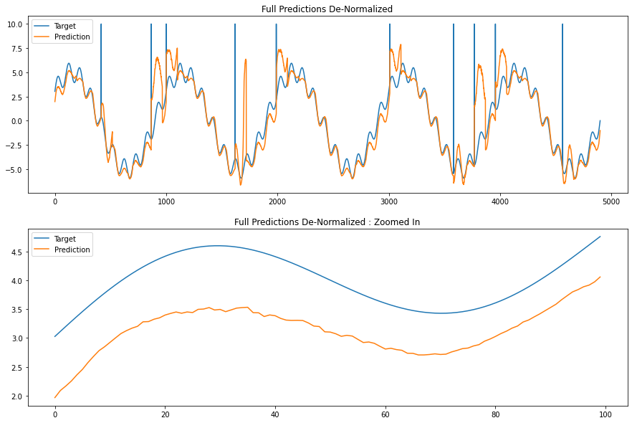
Full prediction denormalized (+noise_2 and impulse)

